Slide 1
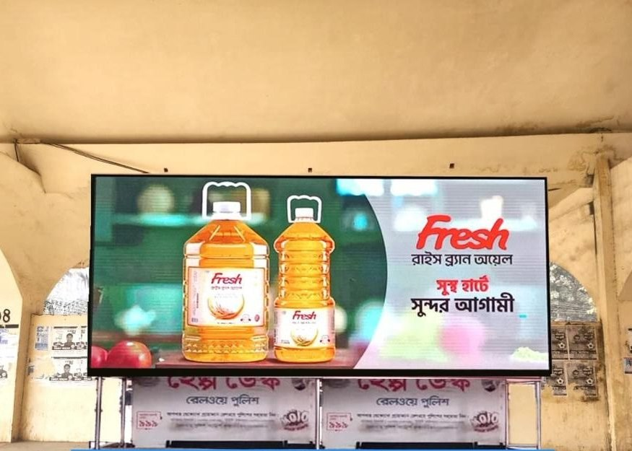

AD PRO
COMMUNICATIONS LTD.
Marketing activation,
outdoor media and
government liaison,
for Uber Bangladesh.
Strategic plan and commercial proposal
Submitted to Uber Bangladesh Ltd. · One-year term · 25 August 2026
Notes:
Open on what we own. Fifty-eight screens, ten cities, and the permissions held in our own name.

Slide 2
THE ANSWER
Most agencies would have to go and rent what Uber is asking for. We already own it.
58
10
0%
24hr
NET60
LED screens owned
and operated
Cities with
AD PRO screens
Markup on every
pass-through taka
Proof of display
after install
Payment terms
accepted
Zero markup, and on our own screens, zero pass-through
No retainer, no account-management fee
Nothing goes up without two approvals
Third-party media, government fees and production are billed at documented actuals. On the screens we own there is no third party at all.
The dedicated team, the permissions desk and all reporting are carried in our margin on work delivered.
Uber's written approval and the authority's permission. Neither alone is enough to put anything on a wall.
AD PRO COMMUNICATIONS LTD.
2 / 8
Notes:
Five numbers. The one that decides it is the zero: on owned media there is no third party to mark up.

Slide 3
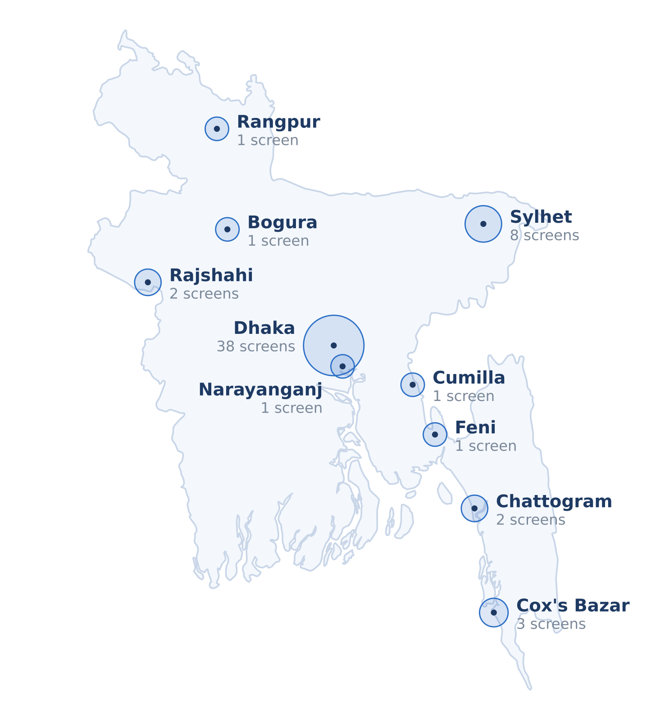
COVERAGE
Ten cities, and a screen in every one of them.
Dhaka
Cumilla
34 screens
1 screen
Sylhet
Rangpur
8 screens
1 screen
Cox's Bazar
Bogura
3 screens
1 screen
Chattogram
Narayanganj
2 screens
1 screen
Rajshahi
Feni
2 screens
1 screen
Head office and studio in Gulshan, Dhaka; registered office in Purana Paltan. Field operations run from Dhaka with resident crews and contracted riggers in each divisional city, which is what keeps a replacement inside the same working day rather than the same week.
AD PRO COMMUNICATIONS LTD.
3 / 8
Notes:
Dot area is proportional to screens in the city. Boundary drawn from Natural Earth 1:10m, public domain.

Slide 4
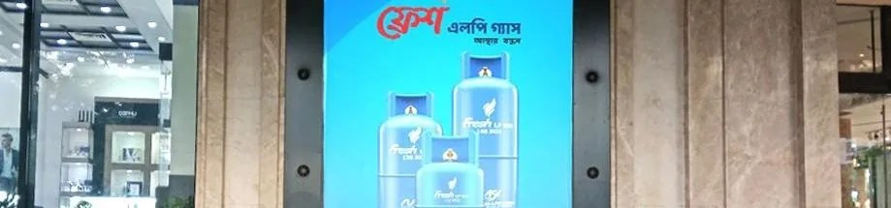
GOVERNMENT LIAISON
The part of this contract that goes wrong is the part we do in-house.
Unauthorised branding in Bangladesh is not a paperwork problem. It is a removal, a fine, and a conversation with a city corporation that then remembers your brand. AD PRO does not subcontract this: every one of our fifty-eight sites is held under permissions we obtained and renew ourselves.
AUTHORITY
LEAD TIME
Dhaka North & South City Corporations
2 to 4 weeks
Billboards, megasigns, wall branding, kiosks
City corporations, nine other cities
2 to 5 weeks
The same categories outside Dhaka
RAJUK
3 to 6 weeks
Structural consent for gantries and unipoles
The two-key rule
DMTCL
3 to 5 weeks
Nothing is installed without Uber's written approval and the authority's permission. Neither key alone opens the site, and AD PRO holds no site on anyone else's licence.
Metro rail coach and station branding
Bangladesh Railway
3 to 5 weeks
Station and track branding, station stores
Civil Aviation Authority / airport
4 to 6 weeks
Airport terminal and approach-road branding
AD PRO COMMUNICATIONS LTD.
4 / 8
Notes:
Permission and government-liaison capability is the heaviest-weighted criterion in the RFP, at 25 per cent.

Slide 5
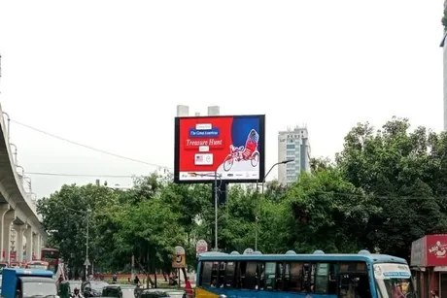
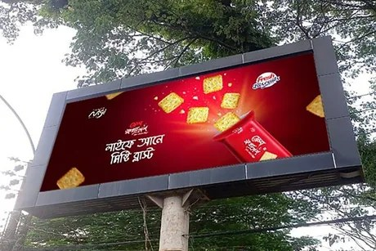
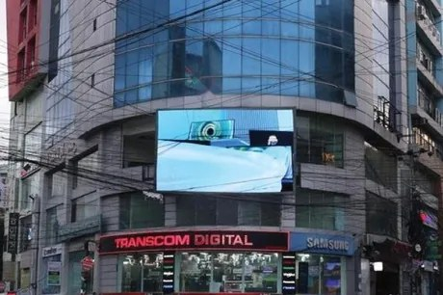
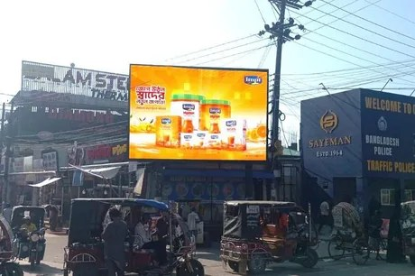
COMMERCIAL · 5.2
The operator’s rate, sold by the minute.
53
50 to 200
0
screens with a published minute rate
BDT per minute, per day, by site
agency margin added to any of them
Dhaka
Sylhet
Chattogram
Cox's Bazar
Priced per minute per day, as the RFP asks. Every rate in the full response is the rate AD PRO charges as the operator of the screen, because AD PRO owns it. There is no media owner in the chain and therefore nothing to pass through.
AD PRO COMMUNICATIONS LTD.
5 / 8
Notes:
53 screens carry a published rate; the balance of the fifty-eight are surveyed and quoted within 24 hours.

Slide 6
COMMERCIAL · 5.3 TO 5.6
Everything else in the scope, under one supplier.
Foot over bridges
Metro rail pillar light boxes
18 DHAKA SITES
134 BOXES ON 67 PILLARS
BDT 700,000 to 2,000,000 per site per year. Mostly 30ft x 5ft both sides; Mirpur-10 runs six sides.
Shahbagh Moor to Purana Paltan Moor, pillars 523-593. BDT 150,000 per box per year. BDT 23,115,000 including VAT.
Airport advertising
LED supply and installation
DOMESTIC ARRIVAL, DHAKA
ON UBER'S OWN PREMISES
Hazrat Shahjalal International, luggage belt wall, W-7' x H-5', on air 7am to 11pm. BDT 2,200,000 per year.
BDT 10,500 per sq ft plus installation and foundation. Worked example 8ft x 12ft, 96 sq ft = BDT 1,208,000.
Metro rail coach branding, LED covered vans and human LED display are priced in the same response, at 5.3.
AD PRO COMMUNICATIONS LTD.
6 / 8
Notes:
Four categories that would otherwise be four separate vendors, each with its own markup.

Slide 7
COMMERCIAL · 5.7 AND 5.8
Everything bought in, at cost.
The rate cards are AD PRO’s own media, priced as the operator. Anything else this contract needs is bought in, and every category of it is billed to Uber at the price AD PRO paid, with the document that proves the price attached to the bill.
BOUGHT IN FOR UBER
BILLED AGAINST
Static billboard, megasign, unipole, wallscape
Media owner's invoice
Brand promoters and activation manpower
Supplier invoice, at cost
No handling fee. No commission. No retainer. No account-management fee.
Government permission and liaison
Official receipt. No liaison charge
Should any circumstance ever warrant one, AD PRO states the reason in writing, shows the cost break-up, and obtains Uber’s prior written agreement before the cost is incurred, as Part 3 of the RFP requires.
Logistics and transportation
Carrier receipt
Storage of Uber materials
Warehouse invoice
Annual account-management / retainer fee
NIL
AD PRO COMMUNICATIONS LTD.
7 / 8
Notes:
Commercial competitiveness and transparency is 20 per cent of the score. This slide is the whole answer to it.

Slide 8
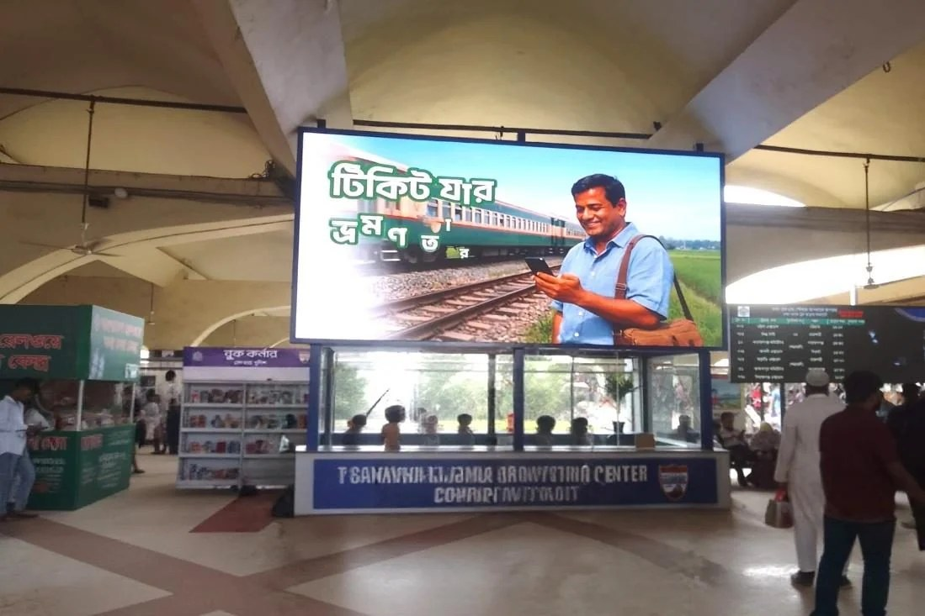
TERMS
Accepted as Uber wrote them.
NET60
Purchase orders
Rate validity
60 days from a correct invoice against an Uber-issued PO
No work commenced and no cost incurred without a valid PO
Re-confirmed every 15 days, re-issued against the same structure
MSA and SOW
Mutual NDA
Contract term
Accepted without redlines on Uber's template
Returned with this submission, completed and unsigned
One year, as proposed
adpro.com.bd · +880 1958 503755 · mkt.adpro@gmail.com
Notes:
Close on the terms, because none of them need negotiating. The full response and every annexure are already with the panel.

